Slide 1
Hospital Management
System
Arava Deepthi
46008916

Slide 2
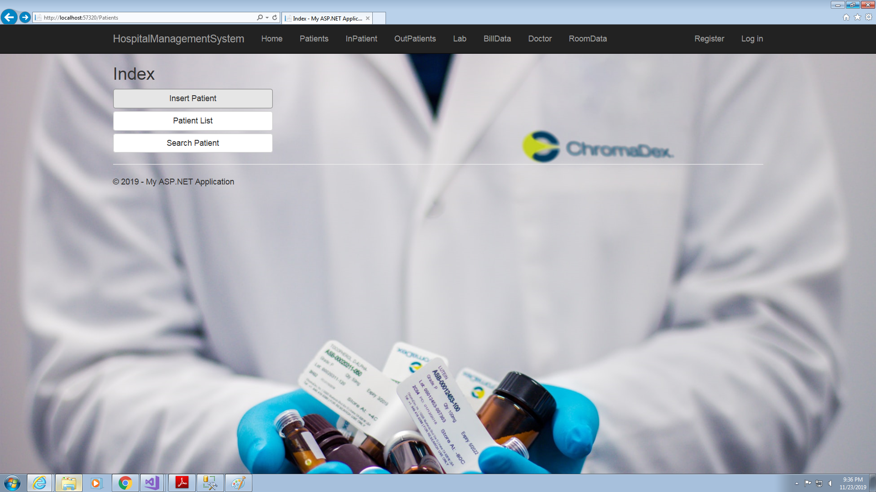
Project Details
Hospital Management System (HMS) is an application, which helps to manage Patient and their treatment details. HMS is also used to generate patient bills and save Patients records in every aspect.

Slide 3
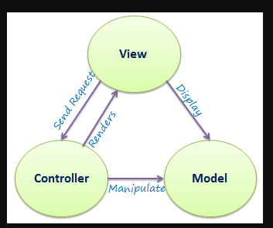
Approach Used :
Three approaches been used while creating this project:
Phase-1: Console Application
Console Application uses collection of classes.
Phase-2: WPF Application
WPF application uses Data Base First approach of Entity Framework.
Phase-3:ASP.NET MVC Application
Application is developed by MVC design pattern Data Base First approach of Entity
Framework.

Slide 4
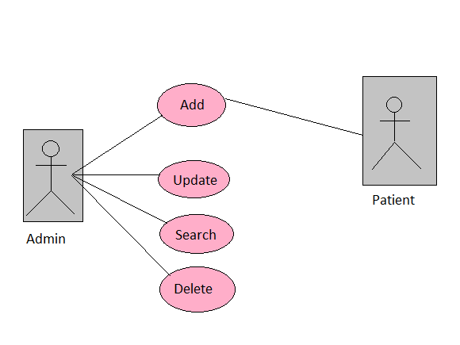
Use Case Diagram

Slide 5
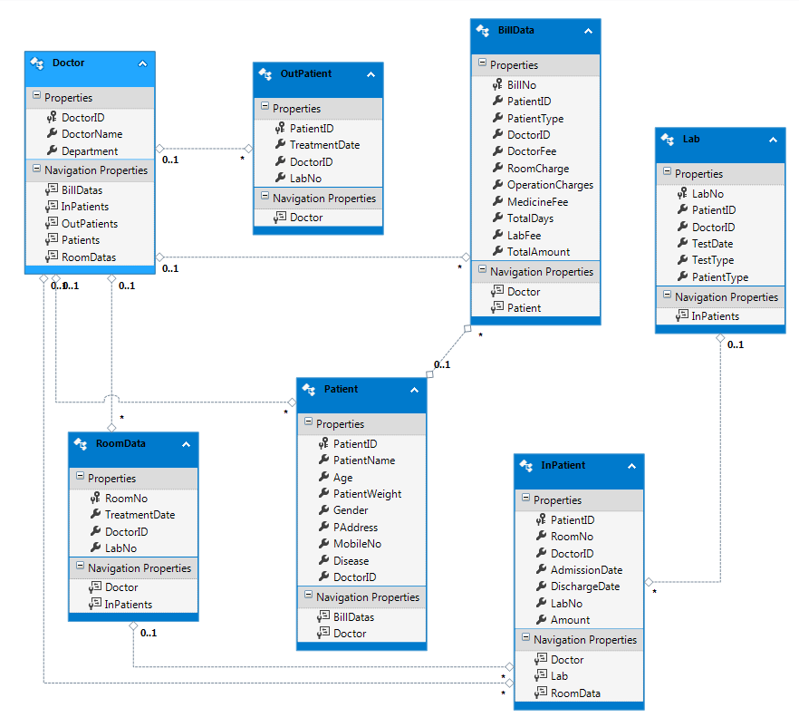
Class Diagram

Slide 6
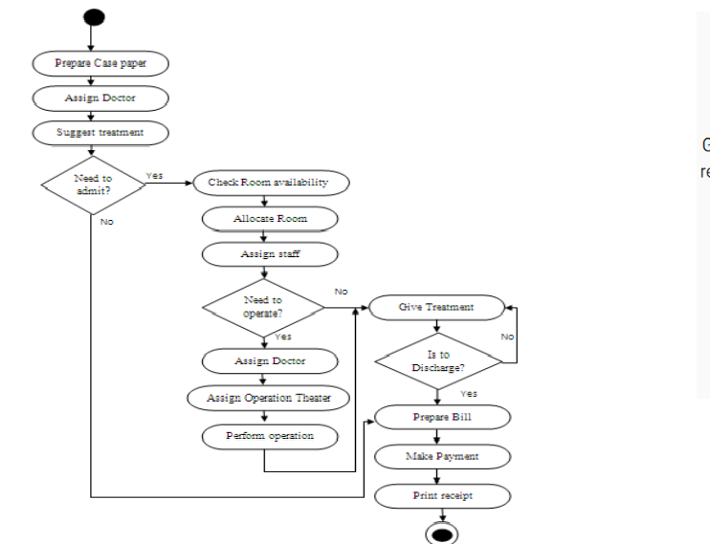
Activity Diagram

Slide 7
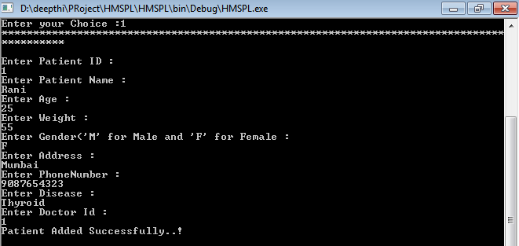
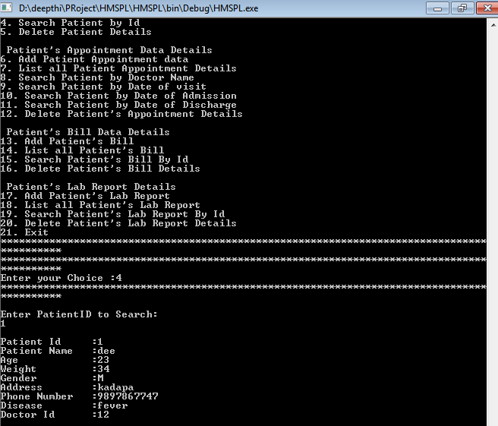
Screen shots-Phase1

Slide 8
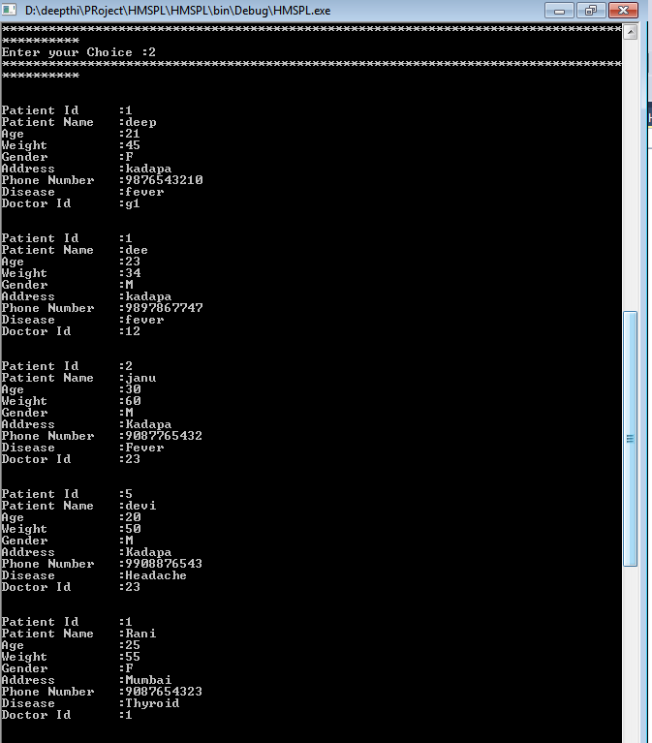
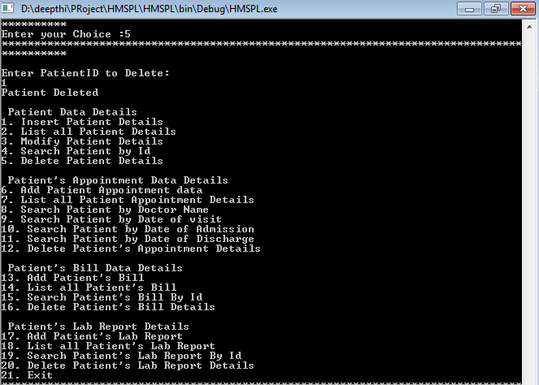
Screen shots

Slide 9
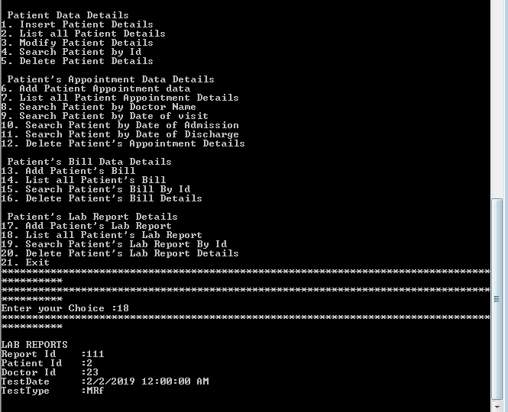
Screen shots

Slide 10
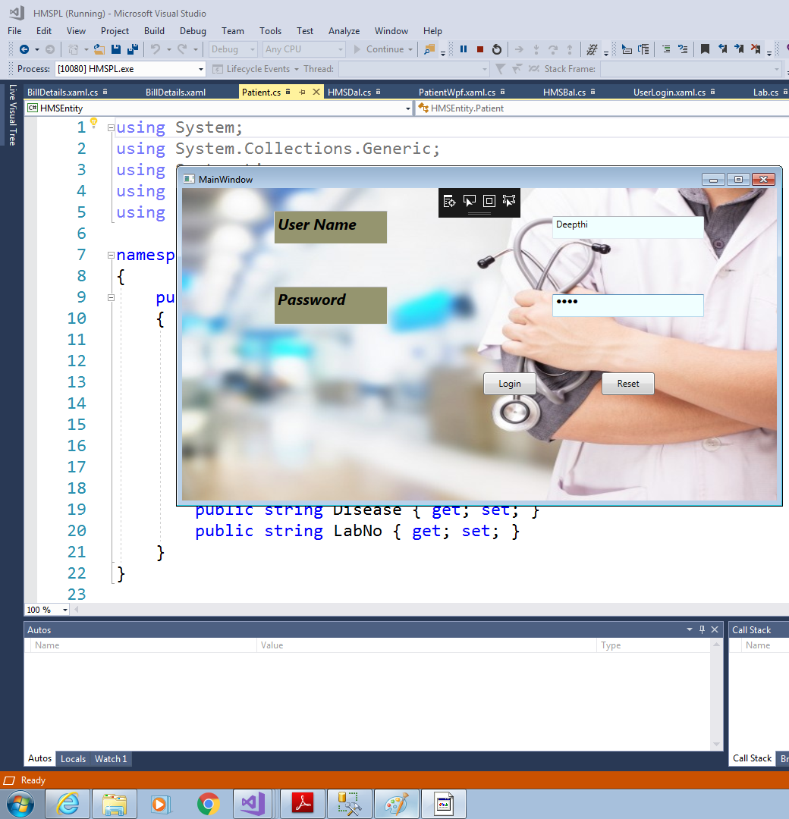
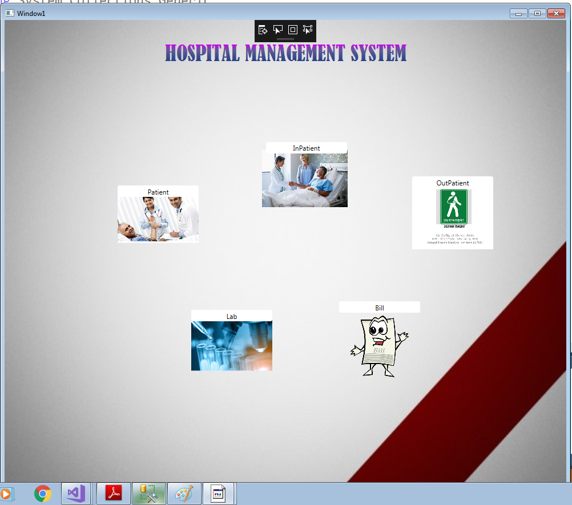
Screen shots-Phase2

Slide 11
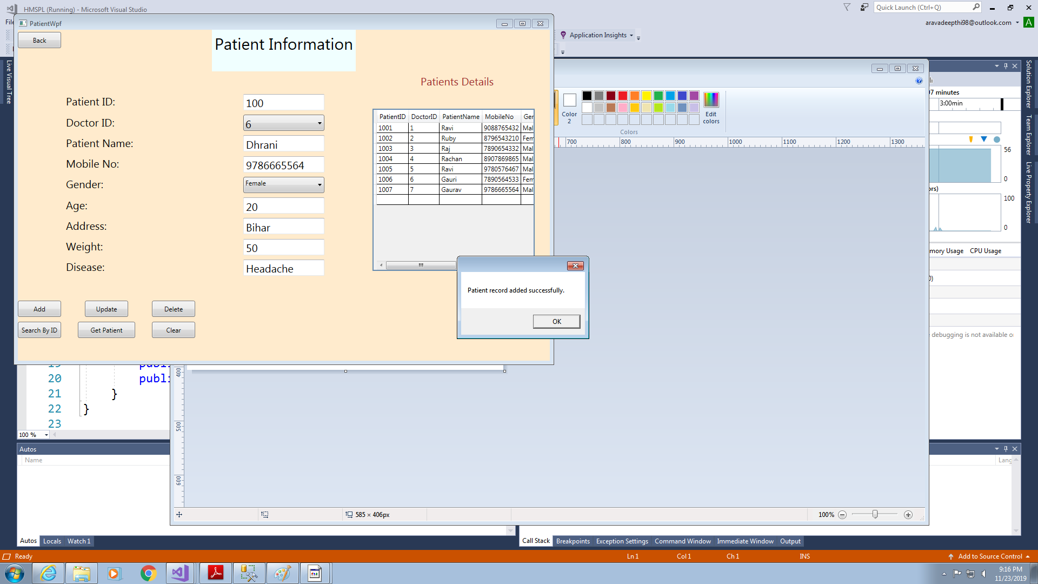
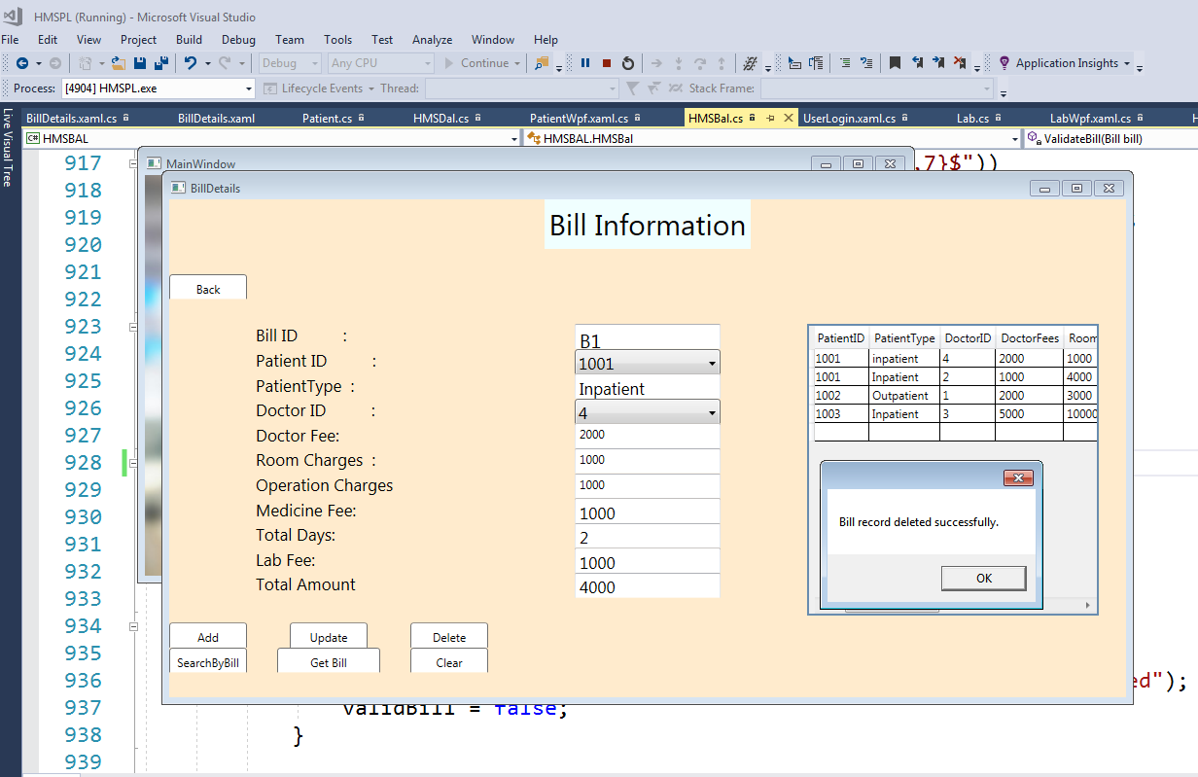

Slide 12
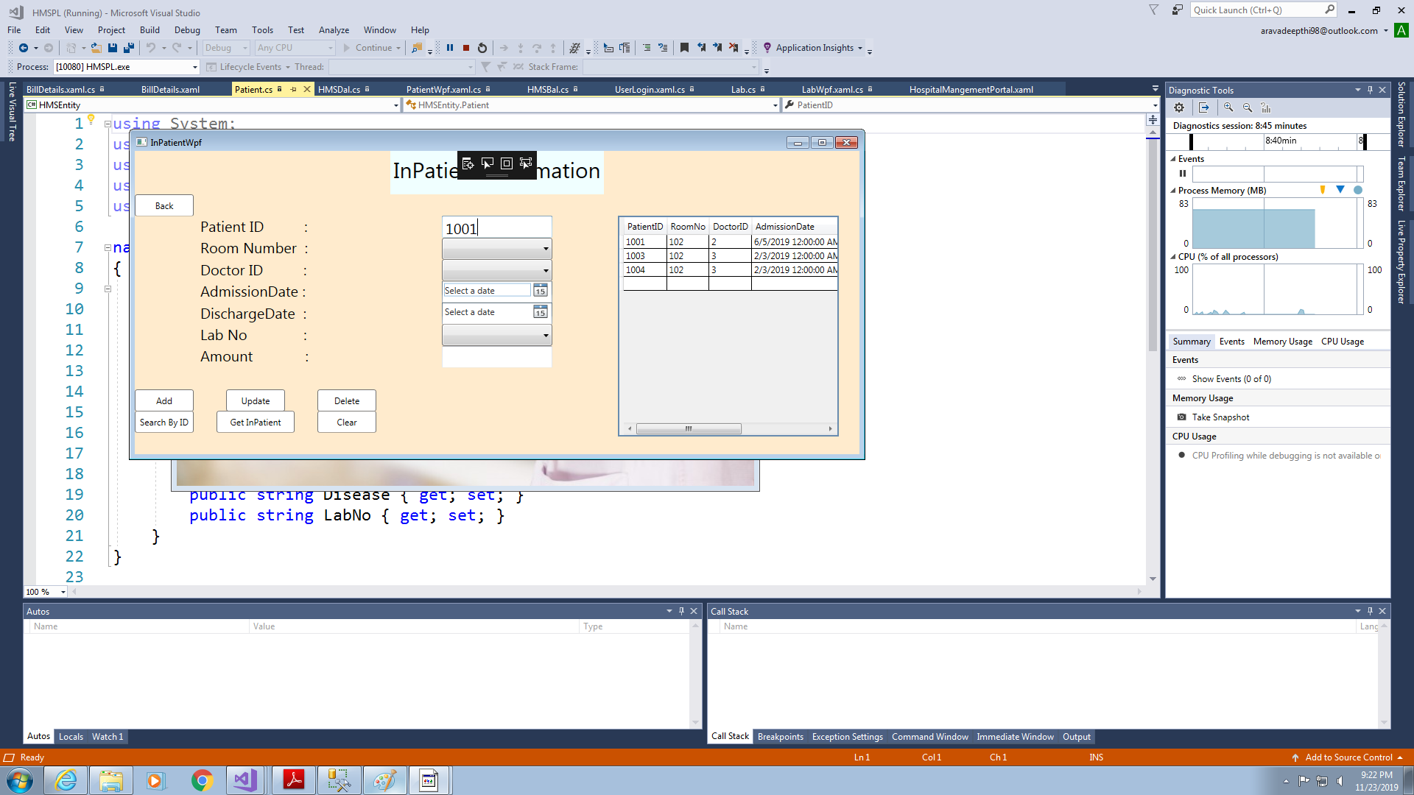

Serach patient by Patient ID

Slide 13
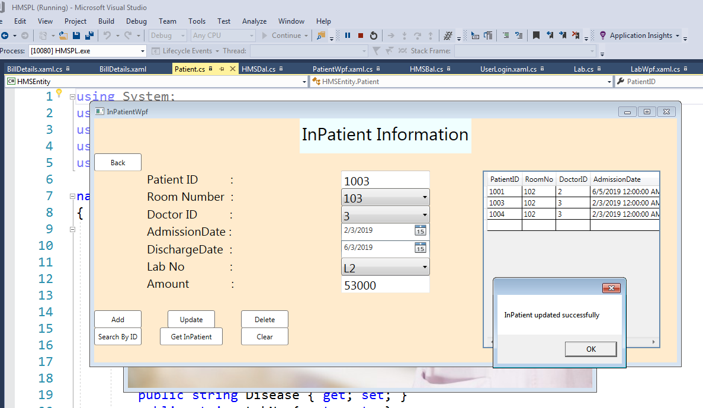
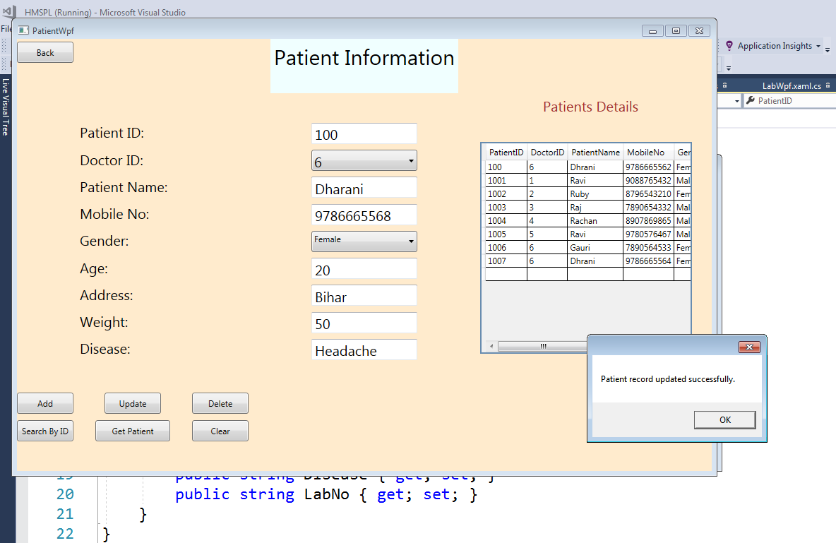
Screen Shots

Slide 14
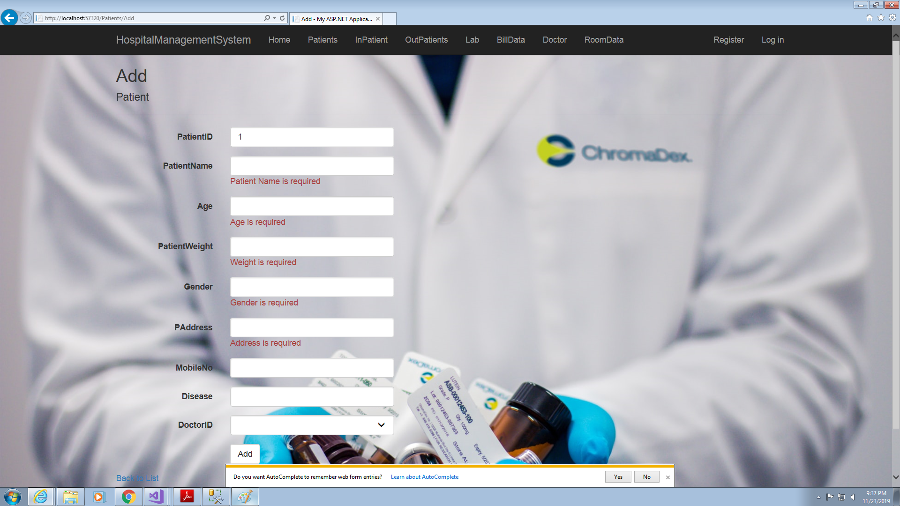
Screenshots-Phase3

Slide 15
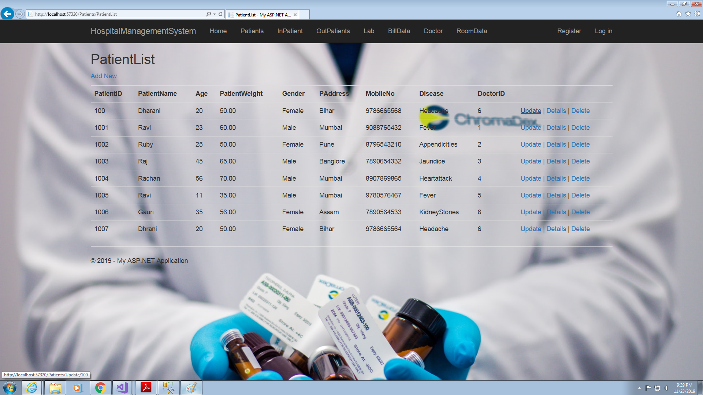
Screen shots

Slide 16
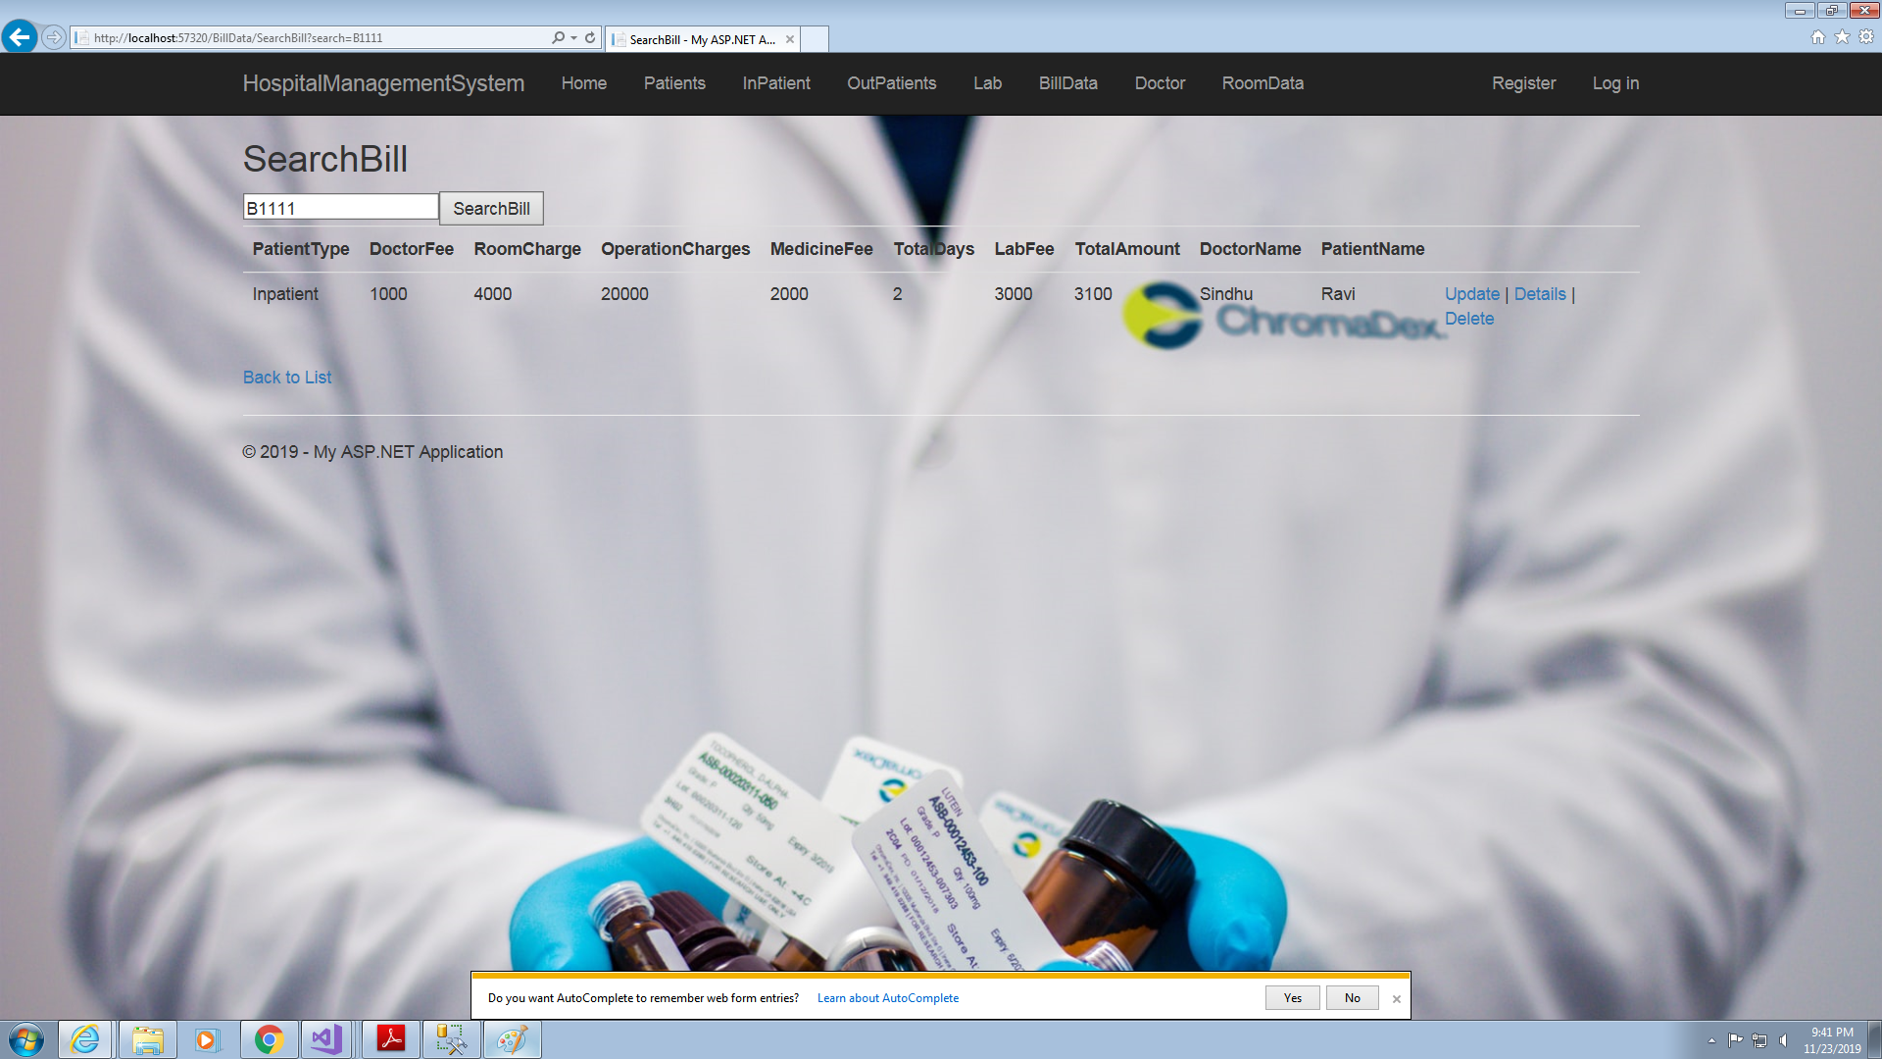
Search Bill by BillID

Slide 17
Future Enhancements
Can implement for the patient will be able to learn about the doctors,
appointments...
Can implement more interactive webpages.

Slide 18


